Slide 1
EDA on IRIS DATA

Slide 2
The features present in the dataset are:
Sepal Width
Sepal Length
Petal Width
Petal Length
IRIS DATA SET

Slide 3
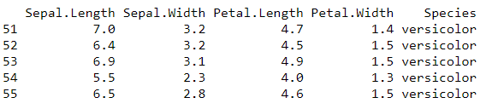
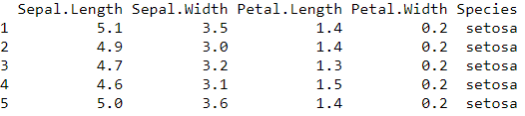
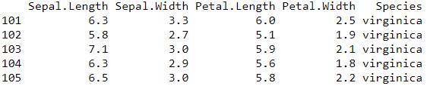
UNDERSTAND THE DATA

Slide 4
Total records=150
Iris Setosa=50 records
Iris Versicolor=50 records
Iris Virginica=50 records.
UNDERSTAND THE DATA

Slide 5
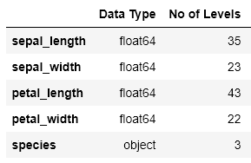
UNDERSTAND THE DATA

Slide 6
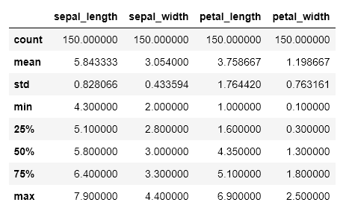
SUMMARY STATISTICS

Slide 7
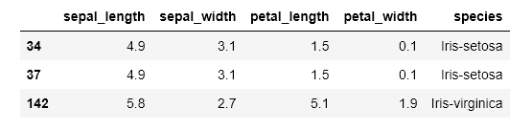
DUPLICATES

Slide 8
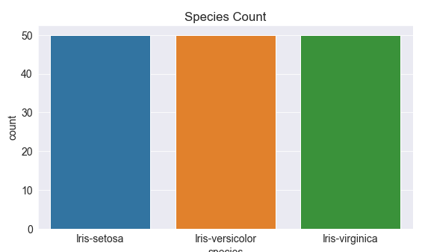
VISUALISATIONS-SPECIES

Slide 9
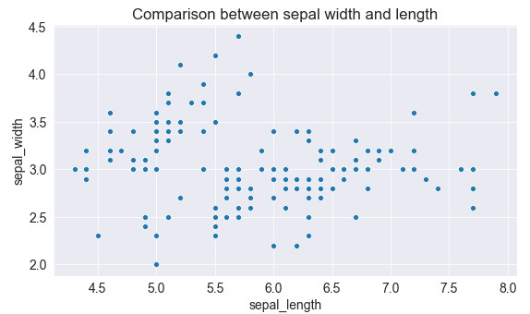
VISUALISATIONS

Slide 10
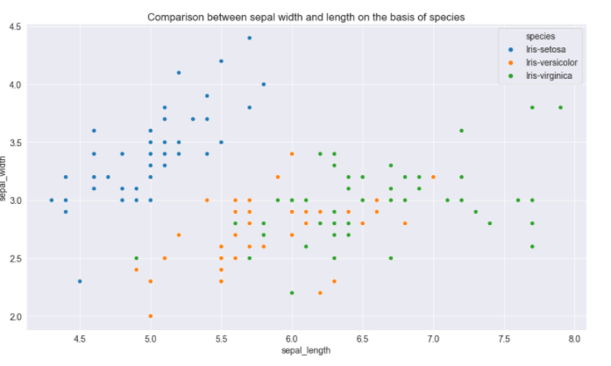
VISUALISATIONS

Slide 11
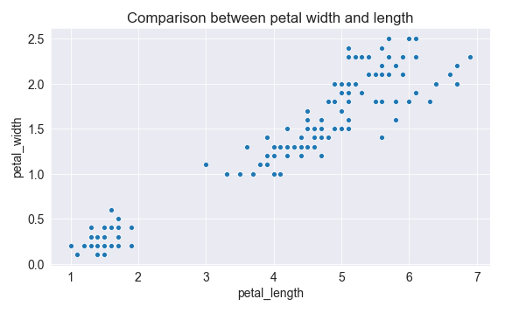
VISUALISATIONS

Slide 12
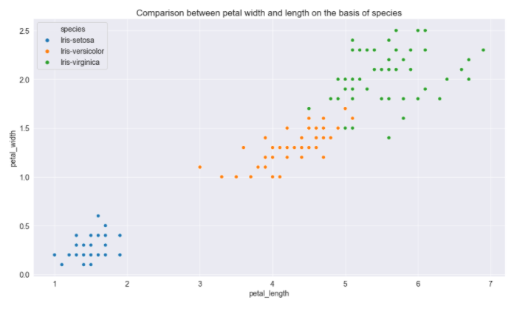
VISUALISATIONS

Slide 13
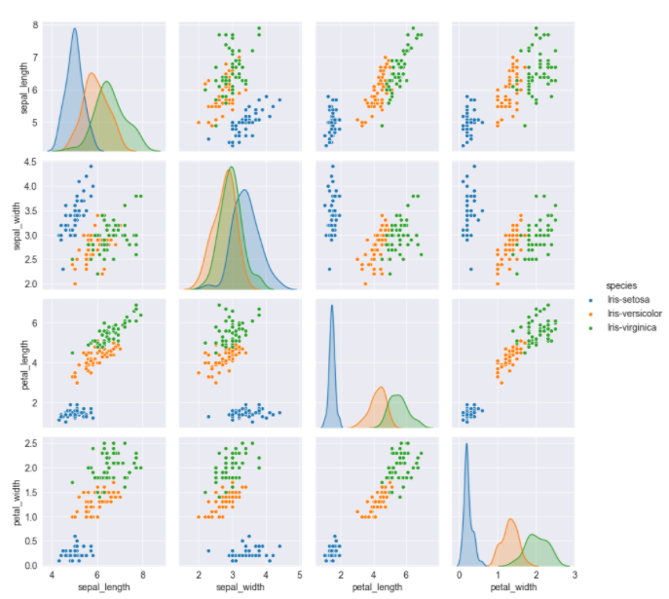

Slide 14
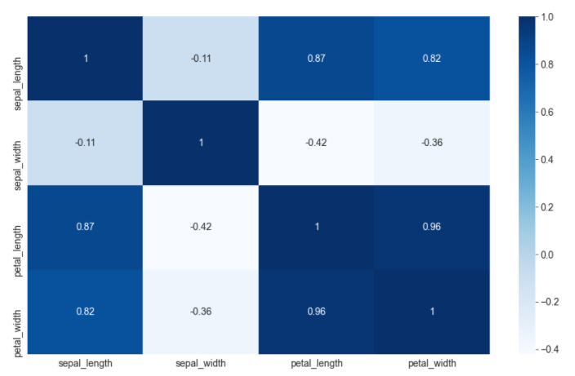
Correlation between Numeric attributes

Slide 15
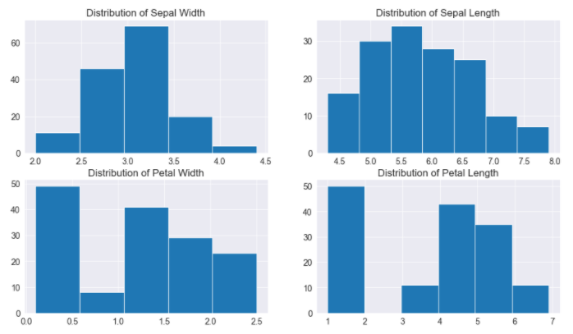
Histograms

Slide 16
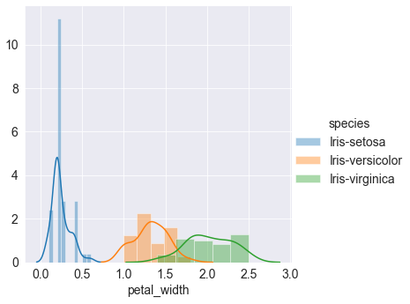
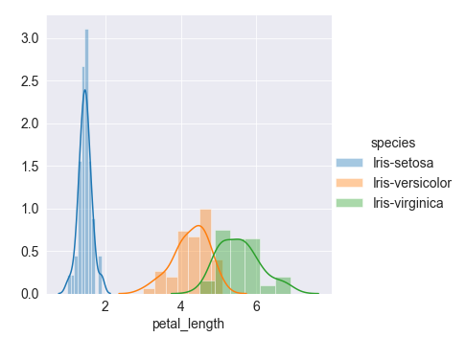
Univariate Analysis of our columns

Slide 17
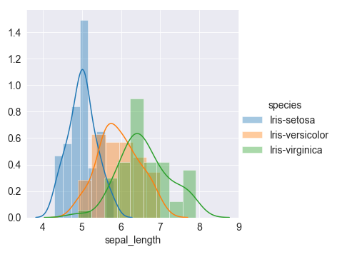
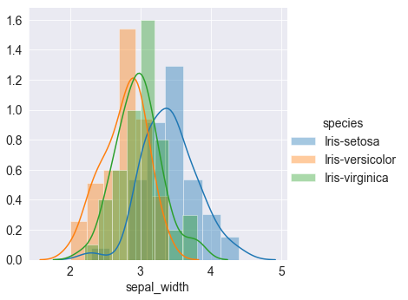
Univariate Analysis

Slide 18
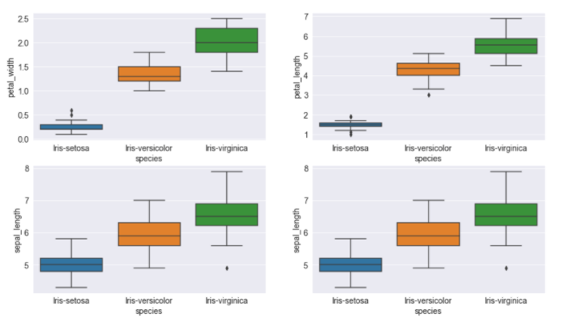
Boxplots

Slide 19
Conclusion
The dataset is balanced i.e. equal records are present for all three species.
We have four numerical columns while just one categorical column which in turn is our target column.
A strong correlation is present between petal width and petal length.
The setosa species is the most easily distinguishable because of its small feature size.
The Versicolor and Virginica species are usually mixed and are sometimes hard to separate, while usually Versicolor has average feature sizes and Virginica has larger feature sizes.

Slide 20
Thank You!

